Slide 1
CC10 Configuration
Business Rules – Exposures and Reserves

Slide 2
Assessment Creation process
Objective
At the end of this session you will be able to :
Write business rules to create exposure for specific cases
Write business rules to create reserves for specific cases

Slide 3
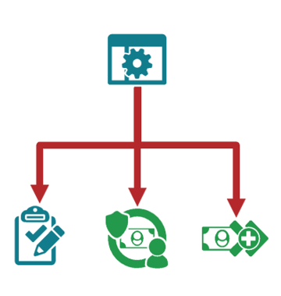
Business Rules
Manage the automated creation of
Activities
Exposure
Reserves
Enable response to changing business needs without coding
Are managed in the ClaimCenter administration UI
Can be designed, tested and deployed without production server downtime
Notes:
The Business rules editor allows an administrative user to create rules that on some condition, create an activity, exposure or a reserve. This provides a mechanism that business analyst can use to respond to changing needs without writing program code or having it written and implemented. The rules are managed from the ClaimCenter administrative user interface. The rules can be designed, tested and deployed without any server downtime.

Slide 4
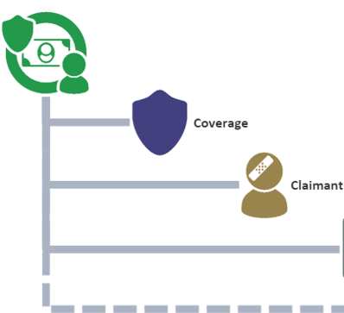
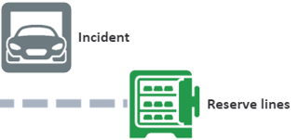
Exposures - Review
An exposure is set of data used to track a potential payment from one coverage to one claimant
It is defined by the specific coverage, claimant, and incident
Reserve lines are optional when the exposure is created
Notes:
An exposure is the mechanism that ClaimCenter uses to track potential payments from one coverage to one claimant.
There are four primary elements within an exposure. First, the coverage from the policy that may cover the loss; next the claimant to whom payment may be made. Next the incident which is the item which was lost or damaged and lastly, the reserves lines which are amounts of money set aside to make the payments.
When an exposure is created, the user must specify the coverage the claimant and the incident.
Reserve lines, which are amounts of money set aside for expected payments may be added later as more information is gathered about the exposure. For example, early in the process of an auto accident claim, there would be a collision exposure for the insured and their vehicle. However, the adjuster may not know how much money should be set aside in the reserve line until after they receive a repair estimate

Slide 5
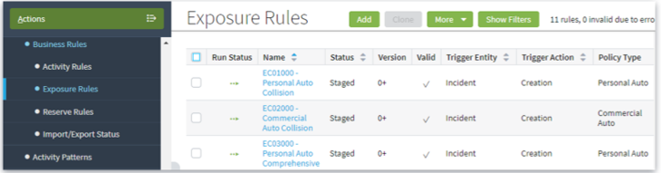
Business rules for exposures
Business rules can automatically create exposures
Business rule definitions control when and what exposures are created
Administrators create the rules and require only limited knowledge of the Guidewire data model
Notes:
Business rules can automate the process of creating exposures. This can be useful when the type and number of exposures is consistent and known for a specific type. For example, a personal auto collision claim will almost always need a collision exposure. The exposure business rules can automatically create that exposure

Slide 6
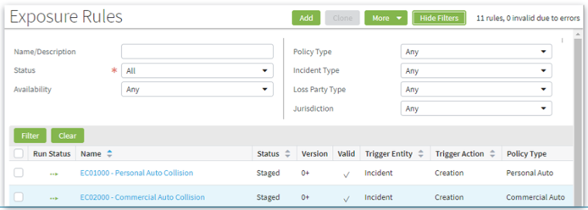
Exposure rule user interface
Navigate to Administration → Business Settings → Business Rules → Exposure Rules
Can filter to show specific rules
Can add, clone, export and import rules
Notes:
The exposure rules user interface is in the Administration screens under Business Settings → Business Rules. The screen shows all the defined exposure rules but you can filter the list of exposure rules by any of the properties in the filter section. Click Show Filters to see the list of available properties that you can use to filter the exposure rules list.
The exposure rules screen shows the status of the rule (is it running in the environment) whether it is staged or draft. The version number the triggering entity, which is always incident and the triggering action which is always creation. From this screen, you can add or clone rules. To edit a rule, click the rule name to open the Rule screen and click edit.

Slide 7
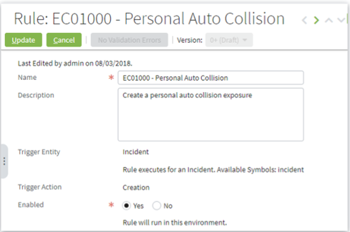
UI Debug options – Under settings menu
Every rule has a:
Name (required)
Description (optional)
Triggering entity
Triggering action
Triggering entity is always incident
Triggering action is always creation
Rules may be enabled or disabled
Notes:
Exposure rules are defined by a name, the triggering entity and the triggering action with an optional description. For exposure rules, the triggering entity is always Incident, which is pre-set. The triggering action determines what type of action triggers the rule to run. Because the triggering action is pre-set to creation, any time an incident is created. The exposure rules will be evaluated.
There is also the enabled status which is set to yes or no. If the status is set to no, then it will not be evaluated.

Slide 8
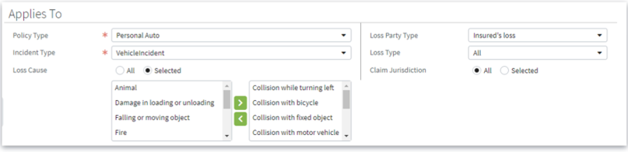
Exposure Rule definition: Applies To
Selections in this section restrict when the rule is executed
Rules can apply to all situations or to selected situations
Click the selected radio button to see and select a valid value
Notes:
Exposure rules are always evaluated when an incident is created. You can restrict the conditions on which the rule applies by specifying Loss Types, Policy Types, and Claim jurisdictions. Setting those values

Slide 9
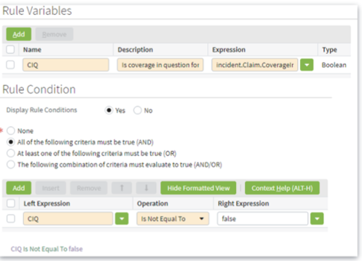
Exposure rule definition: Rule Variables and Condition
Rule condition:
Additional condition(s) which must be met
None: selected means the rule actions are run for all candidates
Conditions can be joined by AND, OR, or some combination
Expression have direct access to the Incident entity.
Rule variable:
Variable(s) created to make the rule condition(s) easier to read
Has access to the same data as conditions
Notes:
To further limit the application of a rule, you can specify Rule conditions. If the Rule Condition is set to None, the rule is not restricted further than you have already specified with the applicability criteria.
You can specify multiple conditions to be evaluated before the rule will execute. You can set that all the conditions must be true by using the And condition. You can use the Or condition to execute the rule if any of the conditions are true or you can also use a combination of both.
You can access entity-specific data in the rule conditions by entering the entity name and using dot notation for data on the entity. In the example, the user does not want an Exposure created if the claim to which the incident belongs in a coverage in question state. To enforce that requirement, the user adds a rule condition that checks that the incident.Claim.CoverageQuestion property is false. If it is false, which means that claim is not in the coverage in question state, the rule will execute

Slide 10
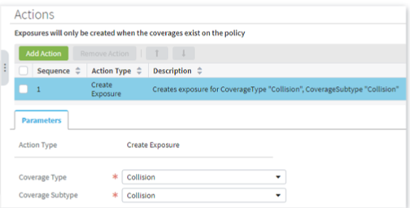
Exposure Rule Definition: Actions
The only action available is Create Exposure
Exposure rules may create multiple exposure
Exposures can be assigned any valid combination of Coverage Type and Coverage Subtype
Notes:
Actions are the “what to do” part of the business rules. When a candidate passes all the restrictions, then the action is executed. Remember that the restrictions include the Applies To and the Rules Conditions sections for the exposure rule.
There may be multiple actions for any exposure rule. This is useful in a case where a given incident would require multiple Exposures. This would be rare.

Slide 11
Reserve Creation
Business Rules

Slide 12
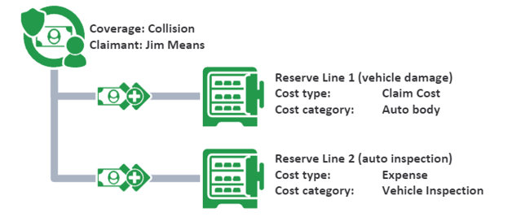
Reserve Lines - Review
A reserve line is an amount of money set aside for expected payments related to a given exposure
Notes:
A reserve line can be thought of as an account set aside for one specific of exposure processing. It contains both credits and debits and its total current “size” is equal to the credits minus the debits
There is no technical requirement for an exposure to have a reserve line. You can create and even close exposures without creating reserve lines. However, you cannot make payments to claimants without reserve lines attached to an exposure.
Reserve lines are defined by the exposure, cost type and the cost category. An exposure may have multiple reserve lines. In this example, the exposure on the collision coverage for John Means has two separate reserve lines; one for the Claim Cost with a category of Auto body and the second for Claim Expense with a category or Vehicle Inspection
ClaimCenter also allows for: reserve lines directly against the claim, although this type of reserve line is rarely used

Slide 13
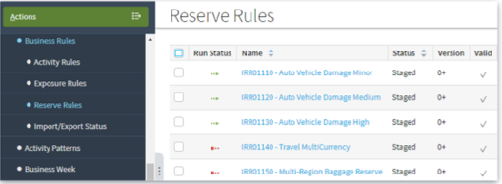
Business rules for Reserve Lines
Business rules can automatically create reserve lines
Business rule definitions control when and what reserve lines are created
Administrators create the rules and require only limited knowledge of the Guidewire data model
Notes:
Reserve rules can automate the process of creating reserves. This can be useful when the type and number of reserves is consistent and known for a specific type of exposure. For example, the insurer may know that an exposure with a loss type of auto, the exposure of type of vehicle and an exposure segment of low complexity; requires a single reserve line of $1,000,00. if this amount is consistent for that type of exposure, then reserve rules can be used to create that reserve automatically

Slide 14
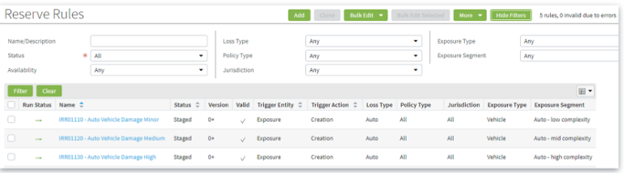
Reserve Rules User Interface
Navigate to Administration → Business Settings → Business Rules → Reserve Rules
Can filter to show specific rules
Can add, clone, export and import rules
Notes:
The ReserveRules user interfaces is in the Administration screens under Business Settings → Business Rules and is similar to the Exposure Rules user interface. The screens shows all the defined reserve rules. But you can filer the list of reserve rules just like the exposure rules. The reserve rules screen also shows the status of the rule ( is it running in the environment) whether it is staged or draft, the version number, the triggering entity which is always Exposure and the triggering action which is always creation.
From this screen, you can add or clone rules. Click the rule name to open the Rule screen and click edit

Slide 15
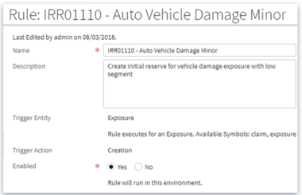
Reserve Rule Definition: Basics
Every rule has a:
Name (required)
Description (optional)
Triggering entity
Triggering action
Triggering entity is always Exposure
Triggering action is always Creation
Rules may be enabled or disabled
Notes:
Reserve rules are defined by a name, the triggering entity and the triggering action with an optional description. For reserve rules, the triggering entity is always Exposure and is pre-set. The triggering action determines what type of action triggers the rule to run. Because the triggering action is pre-set to creation any time Exposure is created. The reserve rules will be evaluated.
You can also set the enabled status to yes or no. if the status is set to no, then it will not be executed.

Slide 16
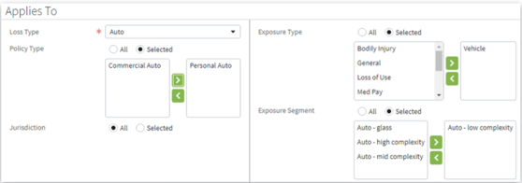
Reserve Rule Definition: Applies To
Selections in the section restrict when the rule is executed
Selecting a value limits what the rule is applied to
Can apply by
Loss Type
Policy Type
Jurisdiction
Exposure Type
Exposure Segment
Select the selected radio button to see and select a valid value
Notes:
Reserve rules are always evaluated when an Exposure is created. You can restrict the conditions on which the rule applies by specifying Loss Types, Policy Types, Claim Jurisdictions, Exposure Type and Exposure Segments. Setting those values restricts or limits the application of the rule. If an Exposure is created which does not match the criteria specified in the Applies To section the rule will not be executed for that incident.
This section is the first of two sections that restrict when the rule is executed. It is also the more user-friendly of the two because it exposes each of the types that can be used along with the valid values. All the user needs to do is select which types and the values that they want to use to restrict the application the rule

Slide 17
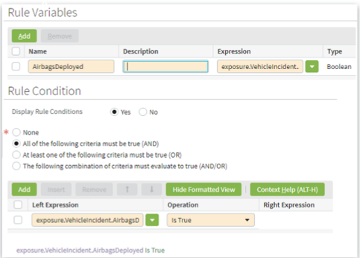
Reserve Rule Definition: Rule Condition
Rule Condition
Additional condition(s) which must be met
None selected means the rules actions are run for all candidates
Conditions can be joined by AND, OR, or some combination
Expressions have direct access to the Exposure and Claim entities
Rule Variable
Variable(s) created to make the rule condition(s) easier to read.
Has access to the same data as condtions
Notes:
To further limit the application of a rule, you can specify Rule Conditions. If the Rule Condition is set to none. The rule is not restricted further than you have already specified with the entity, trigger action.
You can specify multiple conditions to be checked before the rule will execute. You can set that all the conditions must be true by using the And condition. You can use the Or condition to execute the rule if any of the conditions are true. You can also use a combination of both.
You can access entity specific data in the rule conditions by entering the entity name and using dot notation for data on the entity. Reserve rule conditions have access to the Exposure and Claim entities
In the example, the user wants to create a reserve only if the airbag was deployed. To enforce that restriction, the user adds a rule condition that checks that the exposure.VehicleIncident.AirbagsDeployed property is true. If it is true, the rule will execute

Slide 18
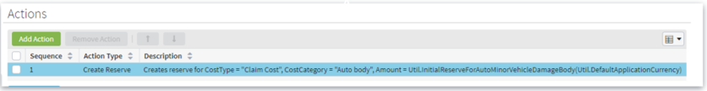
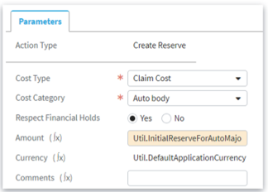
Reserve Rule Definition: Actions
The only action available is Create Reserve
Reserve rules may create multiple reserves
Reserves can be assigned any valid combination of Cost Type and Cost Category
Automatic reserve creation respects Financial Holds
Reserve amount can be
Fixed amount or
Script Parameters
Notes:
Actions are the “what to do” part of the business rules. When a candidate passes all the restrictions then the action is executed. Remember that the restrictions include Applies To and the Riles conditions sections for the reserve rule.
There may be multiple actions for any reserve rule. This is useful when the user wants the rule to create multiple reserves for an exposure. For example, a vehicle exposure with a segment of mid-complexity may require a cost reserve for auto body repair and an expense reserve for inspection or other expenses. To create multiple reserves for an exposure from one rule, add multiple actions to the rule.
The amount of the new reserve may be either a fixed amount or can be specified to use the value of a defined script parameter. In the example, the amount uses the value of InitialReservesForAutoMajorVehicleDamageBody. When a script parameter is used for the value, the rule will use the current value of the parameter. If the value of the parameter is changed then the rule will use the new value. The rule would not need to be updated if the value needed to be changed. Only the script parameter would need to be changed.

Slide 19
Reserve creation Business Rules

Slide 20
Review Question
Under what conditions are exposures rules triggered?
When an incident is created, each exposure rule compares the incident to its Applies To section and any Rule Conditions; if the incident matches, the rule is triggered

Slide 21
Review Question
If a business rule condition access the property exposure.VehicleIncident.AirbagDeployed what kind(s) of business rule can this be?
Either a Reserve business rule or an Activity business rule. Exposure creation rules can only directly access the triggering incident.

Slide 22
Thank you

